Slide 1
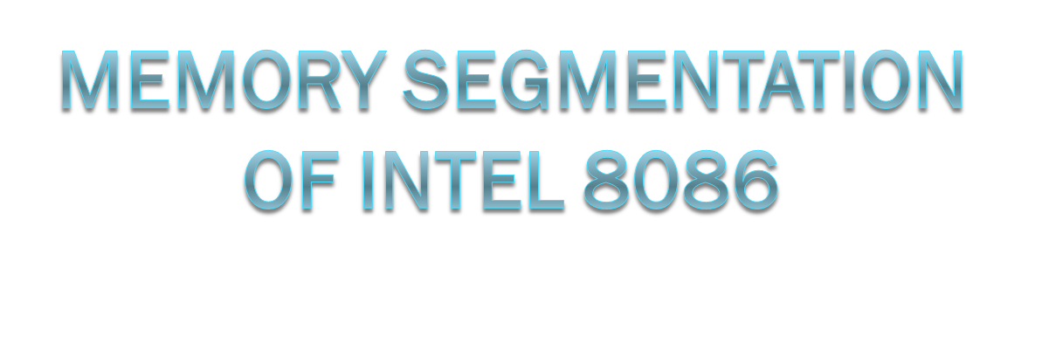
vignan university

Slide 2
Memory Segmentation
The total memory size is divided into segments of various sizes.
A segment is just an area in memory.
The process of dividing memory this way is called Segmentation.
vignan university

Slide 3
Memory Segmentation
In memory, data is stored as bytes.
Each byte has a specific address.
Intel 8086 has 20 lines address bus.
With 20 address lines, the memory that can be addressed is 2²⁰ bytes.
2²⁰ = 1,048,576 bytes (1 MB).
8086 can access memory with address ranging from 00000 H to FFFFF H.
vignan university

Slide 4
Memory Segmentation
In 8086, memory has four different types of segments.
These are:
  Code Segment
  Data Segment
  Stack Segment
  Extra Segment
vignan university

Slide 5
Segment Registers
Each of these segments are addressed by an address stored in corresponding segment register.
These registers are 16-bit in size.
Each register stores the base address (starting address) of the corresponding segment.
Because the segment registers cannot store 20 bits, they only store the upper 16 bits.
vignan university

Slide 6
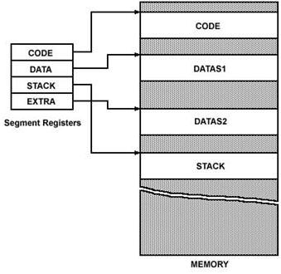
Segment Registers
vignan university

Slide 7
Segment Registers
How is a 20-bit address obtained if there are only 16-bit registers?
The answer lies in the next few slides.
The 20-bit address of a byte is called its Physical Address.
But, it is specified as a Logical Address.
Logical address is in the form of:
  Base Address : Offset
Offset is the displacement of the memory location from the starting location of the segment.
vignan university

Slide 8
Example
The value of Data Segment Register (DS) is 2222 H.
To convert this 16-bit address into 20-bit, the BIU appends 0H to the LSBs of the address.
After appending, the starting address of the Data Segment becomes 22220H.
vignan university

Slide 9
Example (Contd.)
If the data at any location has a logical address specified as:
  2222 H : 0016 H
Then, the number 0016 H is the offset.
2222 H is the value of DS.
vignan university

Slide 10
Example (Contd.)
To calculate the effective address of the memory, BIU uses the following formula:
  Effective Address = Starting Address of Segment + Offset
To find the starting address of the segment, BIU appends the contents of Segment Register with 0H.
Then, it adds offset to it.
vignan university

Slide 11
Example (Contd.)
Therefore:
EA = 22220 H
+ 0016 H
------------
22236 H
vignan university

Slide 12
Example (Contd.)
2222 H
BYTE – 0
BYTE – 1
BYTE – 2
- - - - -
Addressed Byte
22220 H
DS Register
Offset = 0016 H
22236 H
vignan university

Slide 13
Max. Size of Segment
All offsets are limited to 16-bits.
It means that the maximum size possible for segment is 2¹⁶ = 65,535 bytes (64 KB).
The offset of the first location within the segment is 0000 H.
The offset of the last location in the segment is FFFF H.
vignan university

Slide 14
Where to Look for the Offset
Segment | Offset Registers | Function
CS | IP | Address of the next instruction
DS | BX, DI, SI | Address of data
SS | SP, BP | Address in the stack
ES | BX, DI, SI | Address of destination data (for string operations)
vignan university

Slide 15
Question
The contents of the following registers are:
  CS = 1111 H
  DS = 3333 H
  SS = 2526 H
  IP = 1232 H
  SP = 1100 H
  DI = 0020 H
Calculate the corresponding physical addresses for the address bytes in CS, DS and SS.
vignan university

Slide 16
Solution
1. CS = 1111 H
The base address of the code segment is 11110 H.
Effective address of memory is given by 11110H + 1232H = 12342H.
2. DS = 3333 H
The base address of the data segment is 33330 H.
Effective address of memory is given by 33330H + 0020H = 33350H.
3. SS = 2526 H
The base address of the stack segment is 25260 H.
Effective address of memory is given by 25260H + 1100H = 26350H.
vignan university

Slide 17



vignan university

